Slide 1


Smart-Insect Monitoring System Integration and Interaction via AI Cloud Deployment and GPT
Ahmed Moustafa
Under Supervision of Dr. Khoa Luu, CVIU Lab Dept. of Computer Science, University of Arkansas
April 26, 2023 Thesis Defense

Slide 2
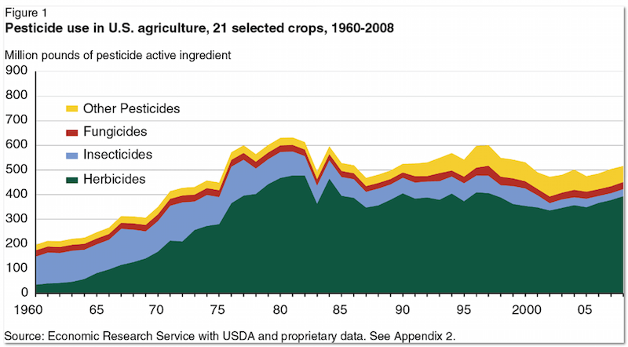
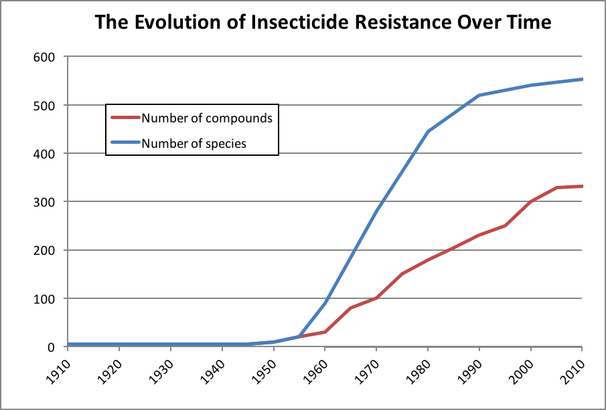
Motivation
U.S. Farms alone generate $164.7 billion annually
Pest management can cost “~34% of a farmer’s variable crop production costs”
Traditional pesticide use has many risks

Slide 3
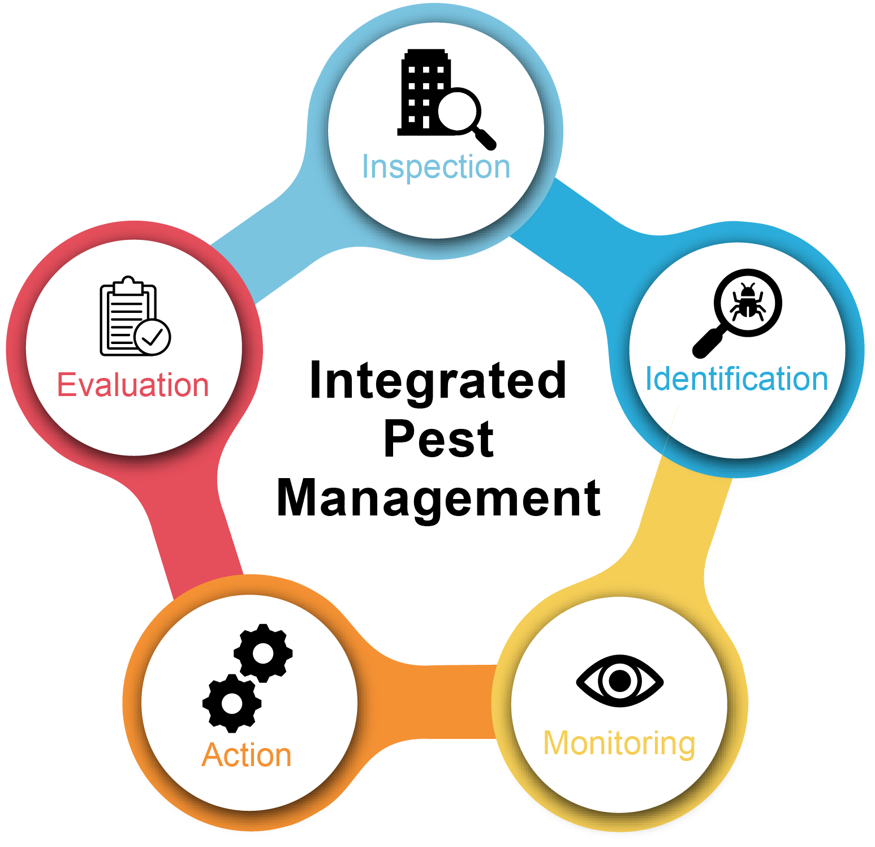
Introduction
Deploy AI models to assist farmers in their IPM plans
Reduce time spent on identification and monitoring
Enable access to expert level information
Integrate on-site bug system with user-facing application

Slide 4
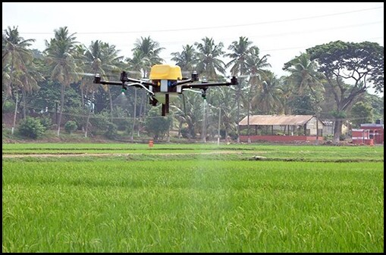
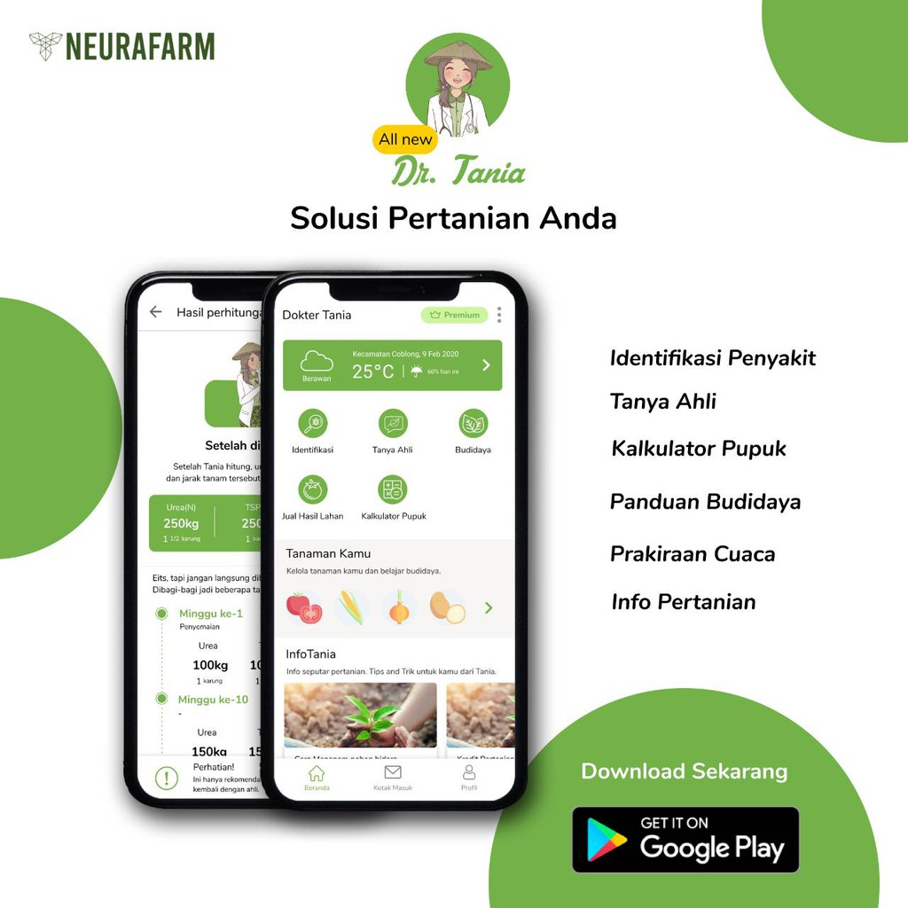
Related Works
Automated farm management systems
Greenhouse insect detection
UAV pest detection
Support tool that uses chatbot recommendations for crop diseases

Slide 5
Background

Slide 6
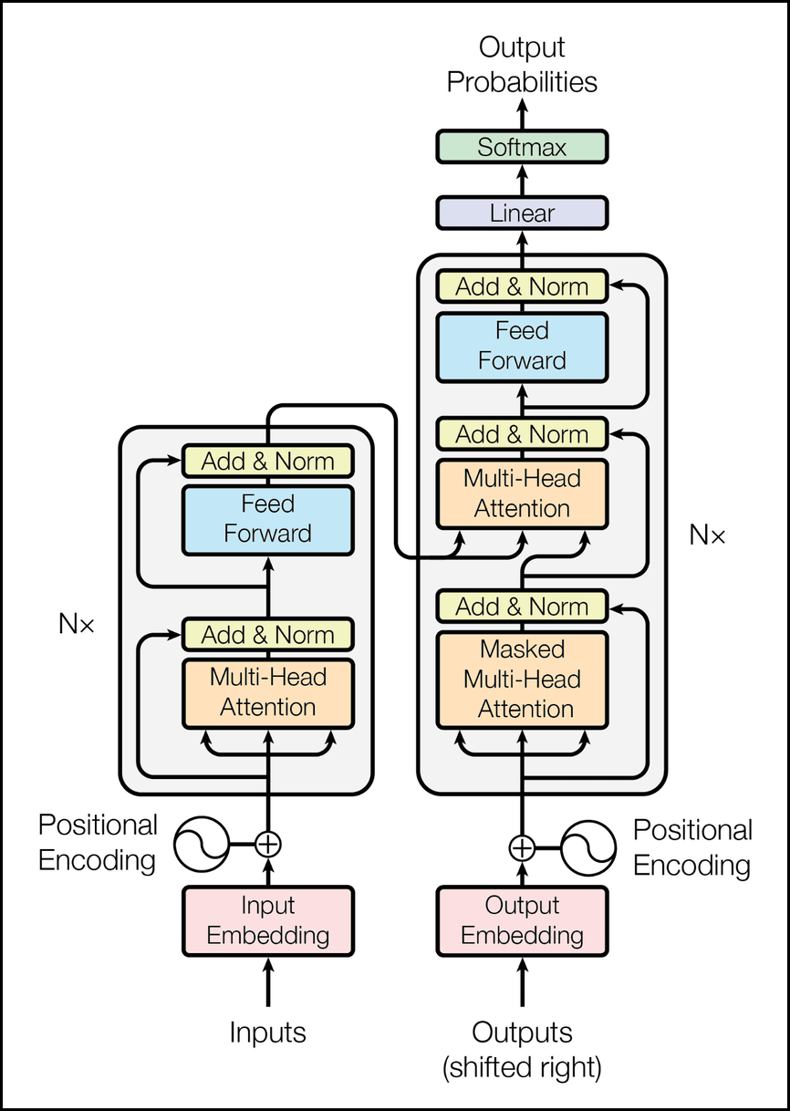
Transformers
Layers & Attention
Multi-layered encoder-decoder architecture with self-attention mechanism
Focus on relevant parts of the input sequence while processing
Positional Encoding
Injects positional information into input sequences
Distinguish the order of words (self-attention mechanism lacks inherent order awareness)

Slide 7
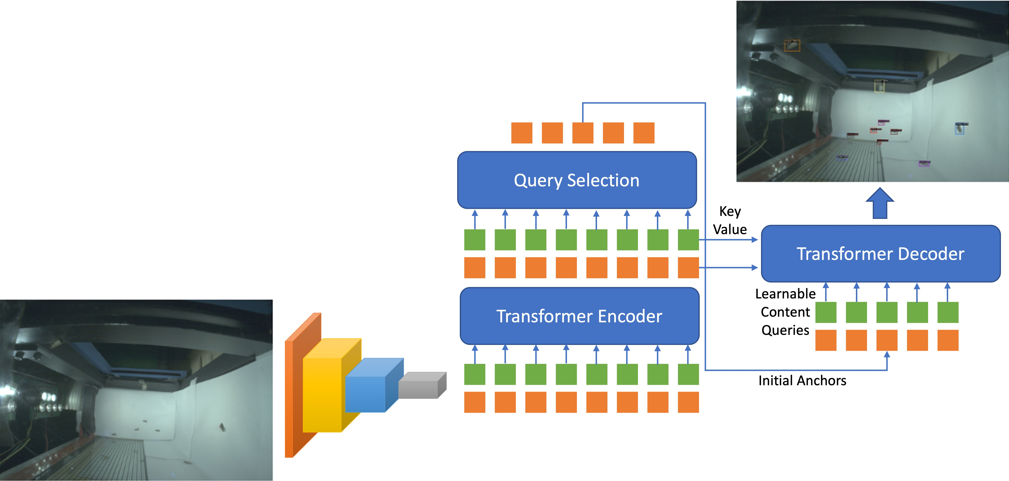
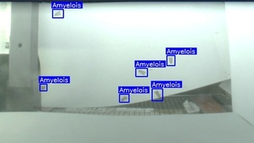
Bug System
2,205 annotated image dataset
Detection Transformer (DETR) for insect detection model
Vision Transformer for insect classification model
Project Confidential

Slide 8
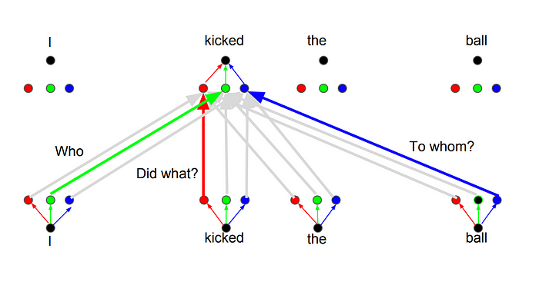
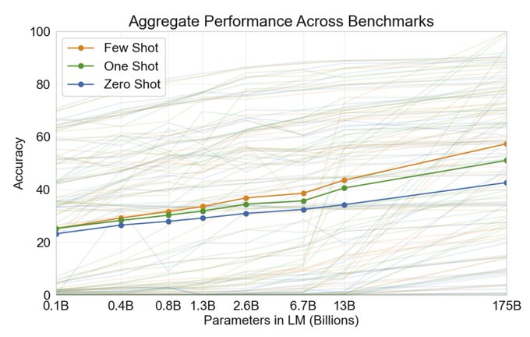
Generative Pretrained Transformer
GPT is a groundbreaking large language model (LLM)
Unsupervised pre-training
Supervised fine-tuning
Transformer Multi-head attention

Slide 9
IMPLEMENTATION

Slide 10

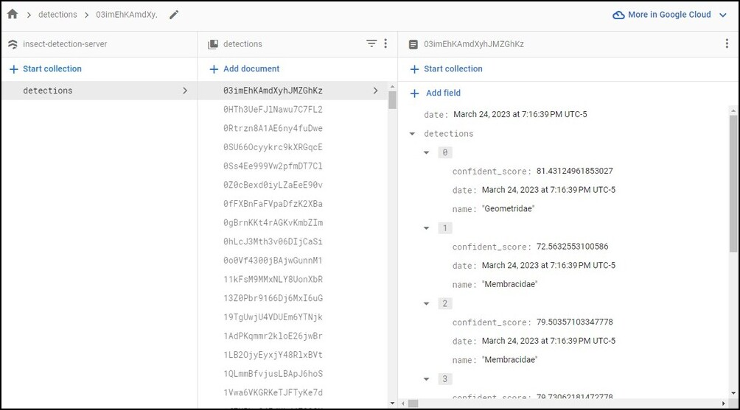
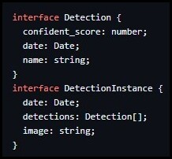
Database
Google Cloud Firestore
Project Confidential

Slide 11
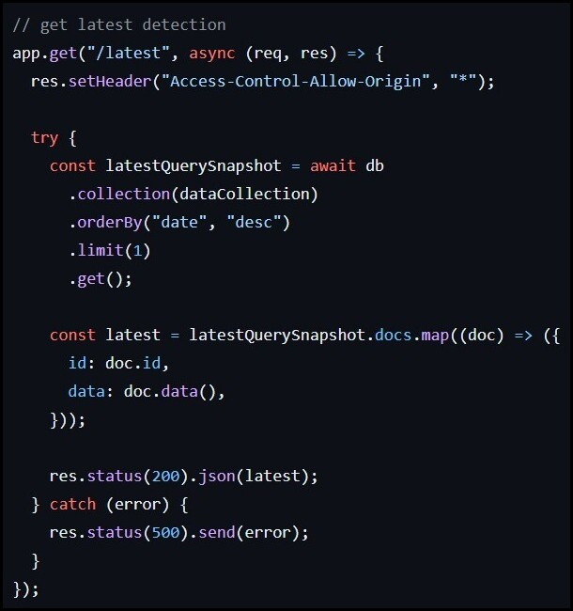
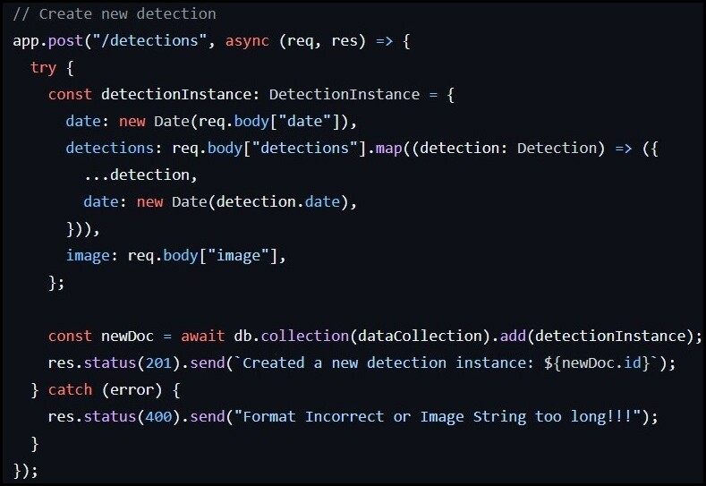
API
Connect frontend, on-site machine, and the database
TypeScript, Express.js, Node.js, Firebase Functions
Project Confidential

Slide 12
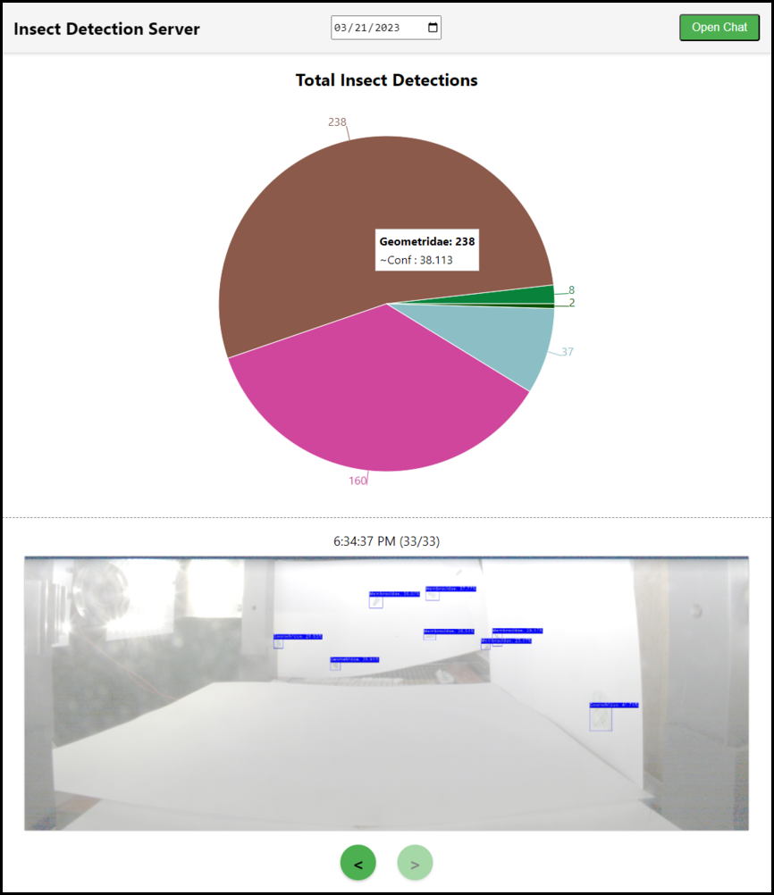
Frontend
Intuitive UI to monitor insect detections & classifications daily and review individual detection instances
TypeScript, React, Node.js. Recharts
Deployed on Netlify
Project Confidential

Slide 13
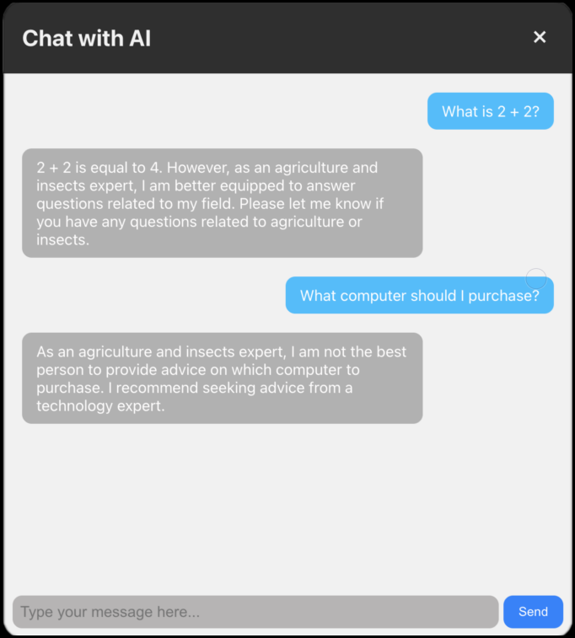
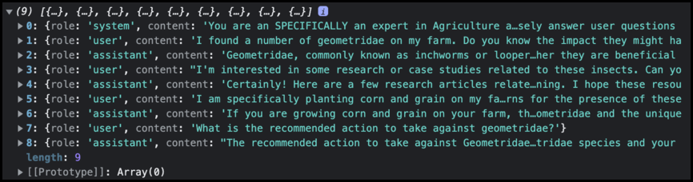
AI Chat Feature
OpenAI’s GPT-3.5 API
Prompt engineering experimentation
Narrow scope of model’s responses
Promote relevant conversations
Project Confidential

Slide 14
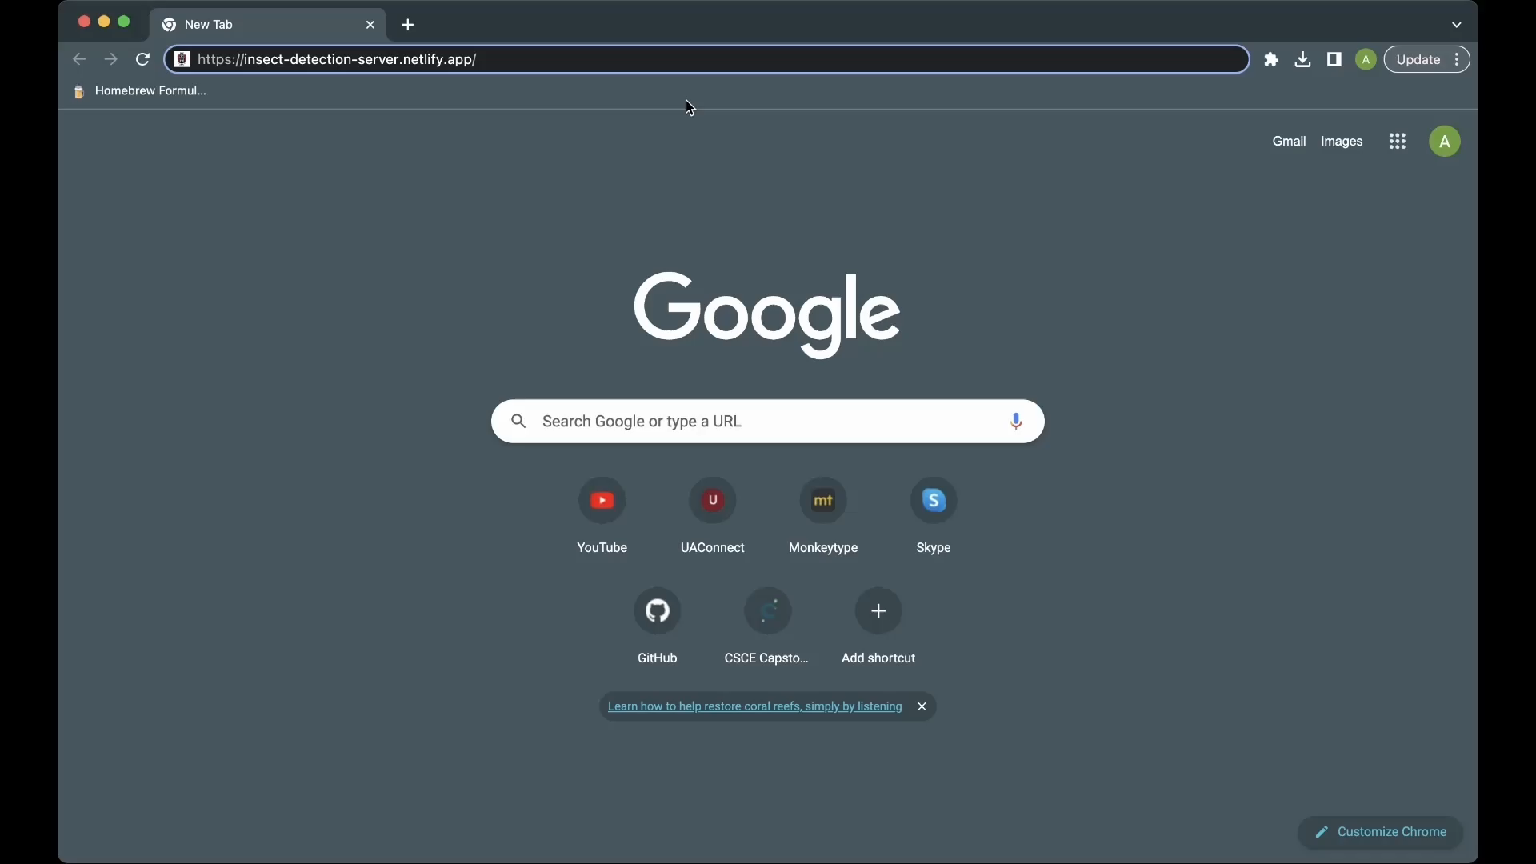
DEMO

Slide 15
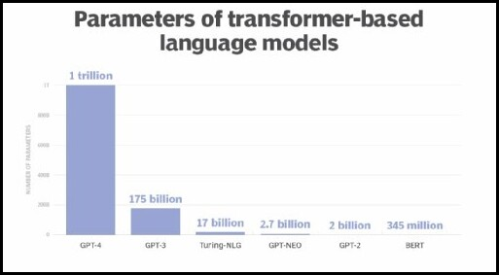
Future Work
Integration of GPT-4 model for enhanced discussion complexity
Refine prompt engineering for relevant and accurate AI responses to evolving agricultural practices
Set up multi-machine data retrieval per user

Slide 16
Acknowledgements
Huge thank you to:
University of Arkansas Honors Program
Dr. Khoa Luu
Thanh-Dat Truong
The defense committee

